Slide 1
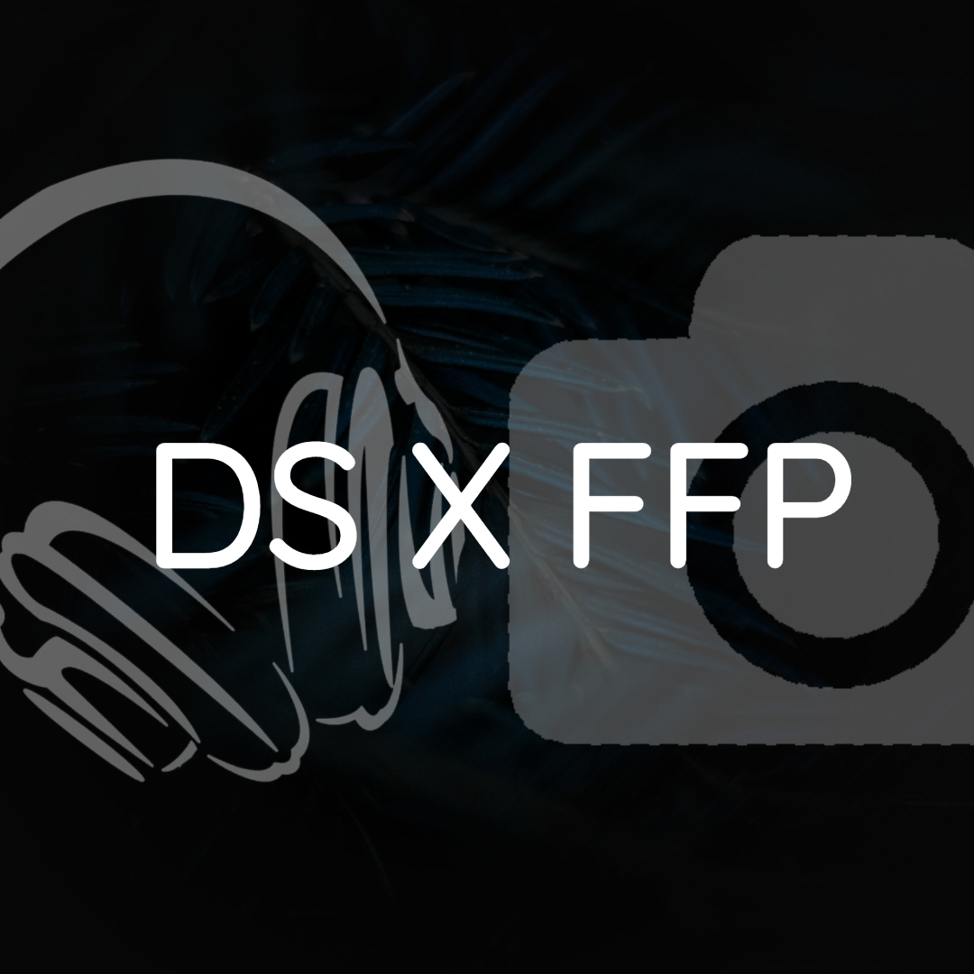
TEAM MEMBERS:
Gautam Kumar (1DS18CS710)
Rithvik K Bhat (1DS18CS732)
Suhaan YM (1DS18CS742)
Vignesh K (1DS18CS744)

Slide 2
INTRODUCTION
A collaboration website that allows visitors to listen to music and view media. Visitors can browse through a large collection of music, photos and videos.
A few tools have been added such as to allow users to make edits to their own photos and download them, a music player that can also play in the background while the user is doing some other work to improve his/her productivity.

Slide 3
ABSTRACT
The project was built using HTML 5, CSS 3, BOOTSTRAP 5 and JavaScript.
A contact form that connects to our email address has also been added using an API called Formsubmit.
This reduces the process of managing emails 30% more efficient compared to traditional methods.
The music player was built from scratch and plays high quality music which have been composed by our very own teammate.
We also have added a photo gallery that showcases a collection of original photos taken by another teammate of ours.
Overall, it has been a great experience learning new things while developing this project as a team.

Slide 4
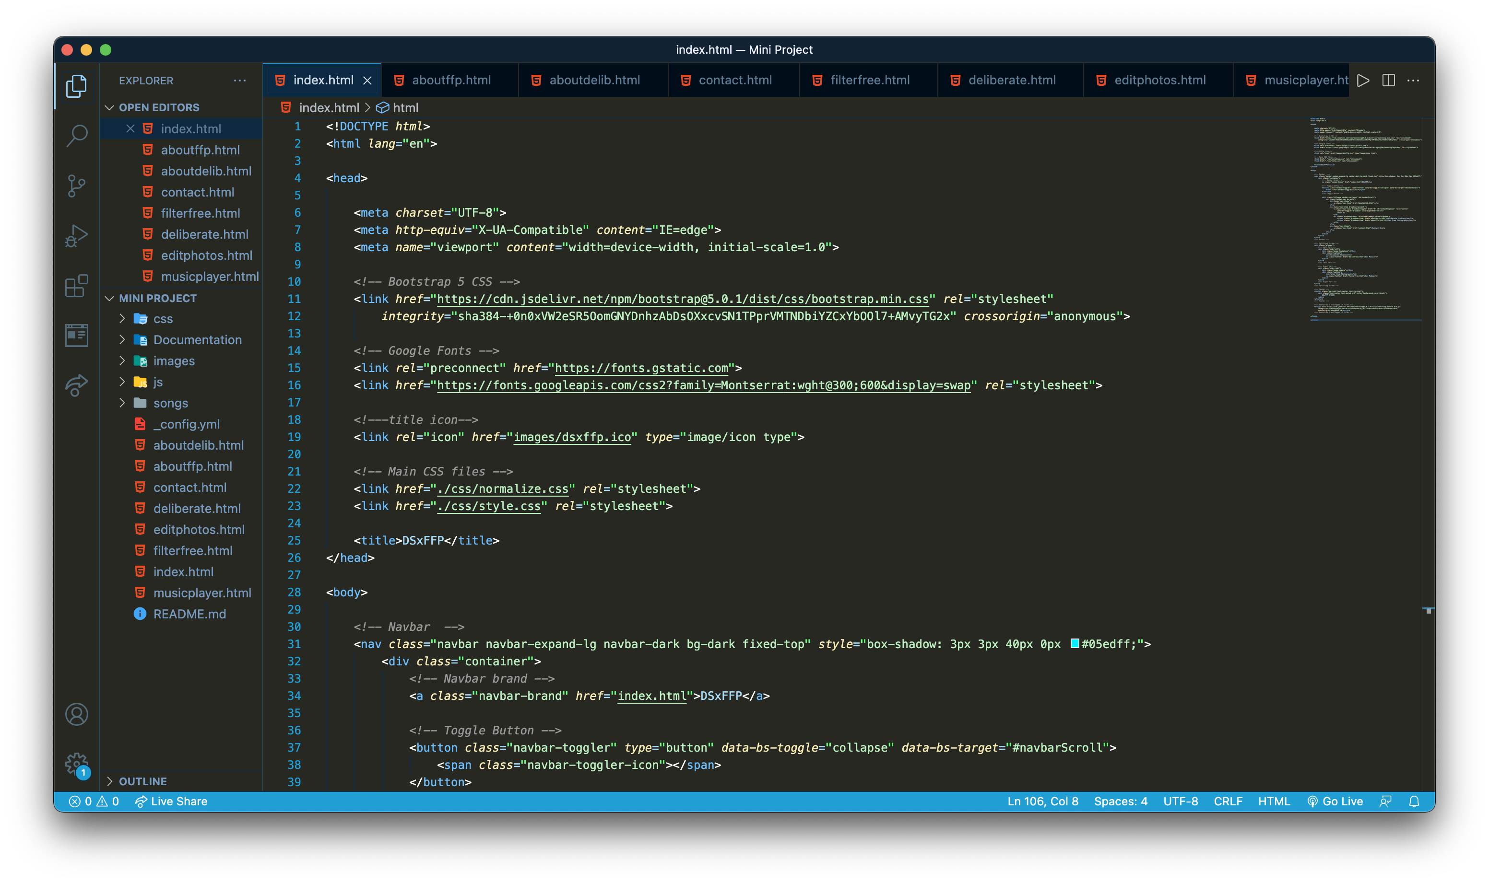
IMPLEMENTATION

Slide 5
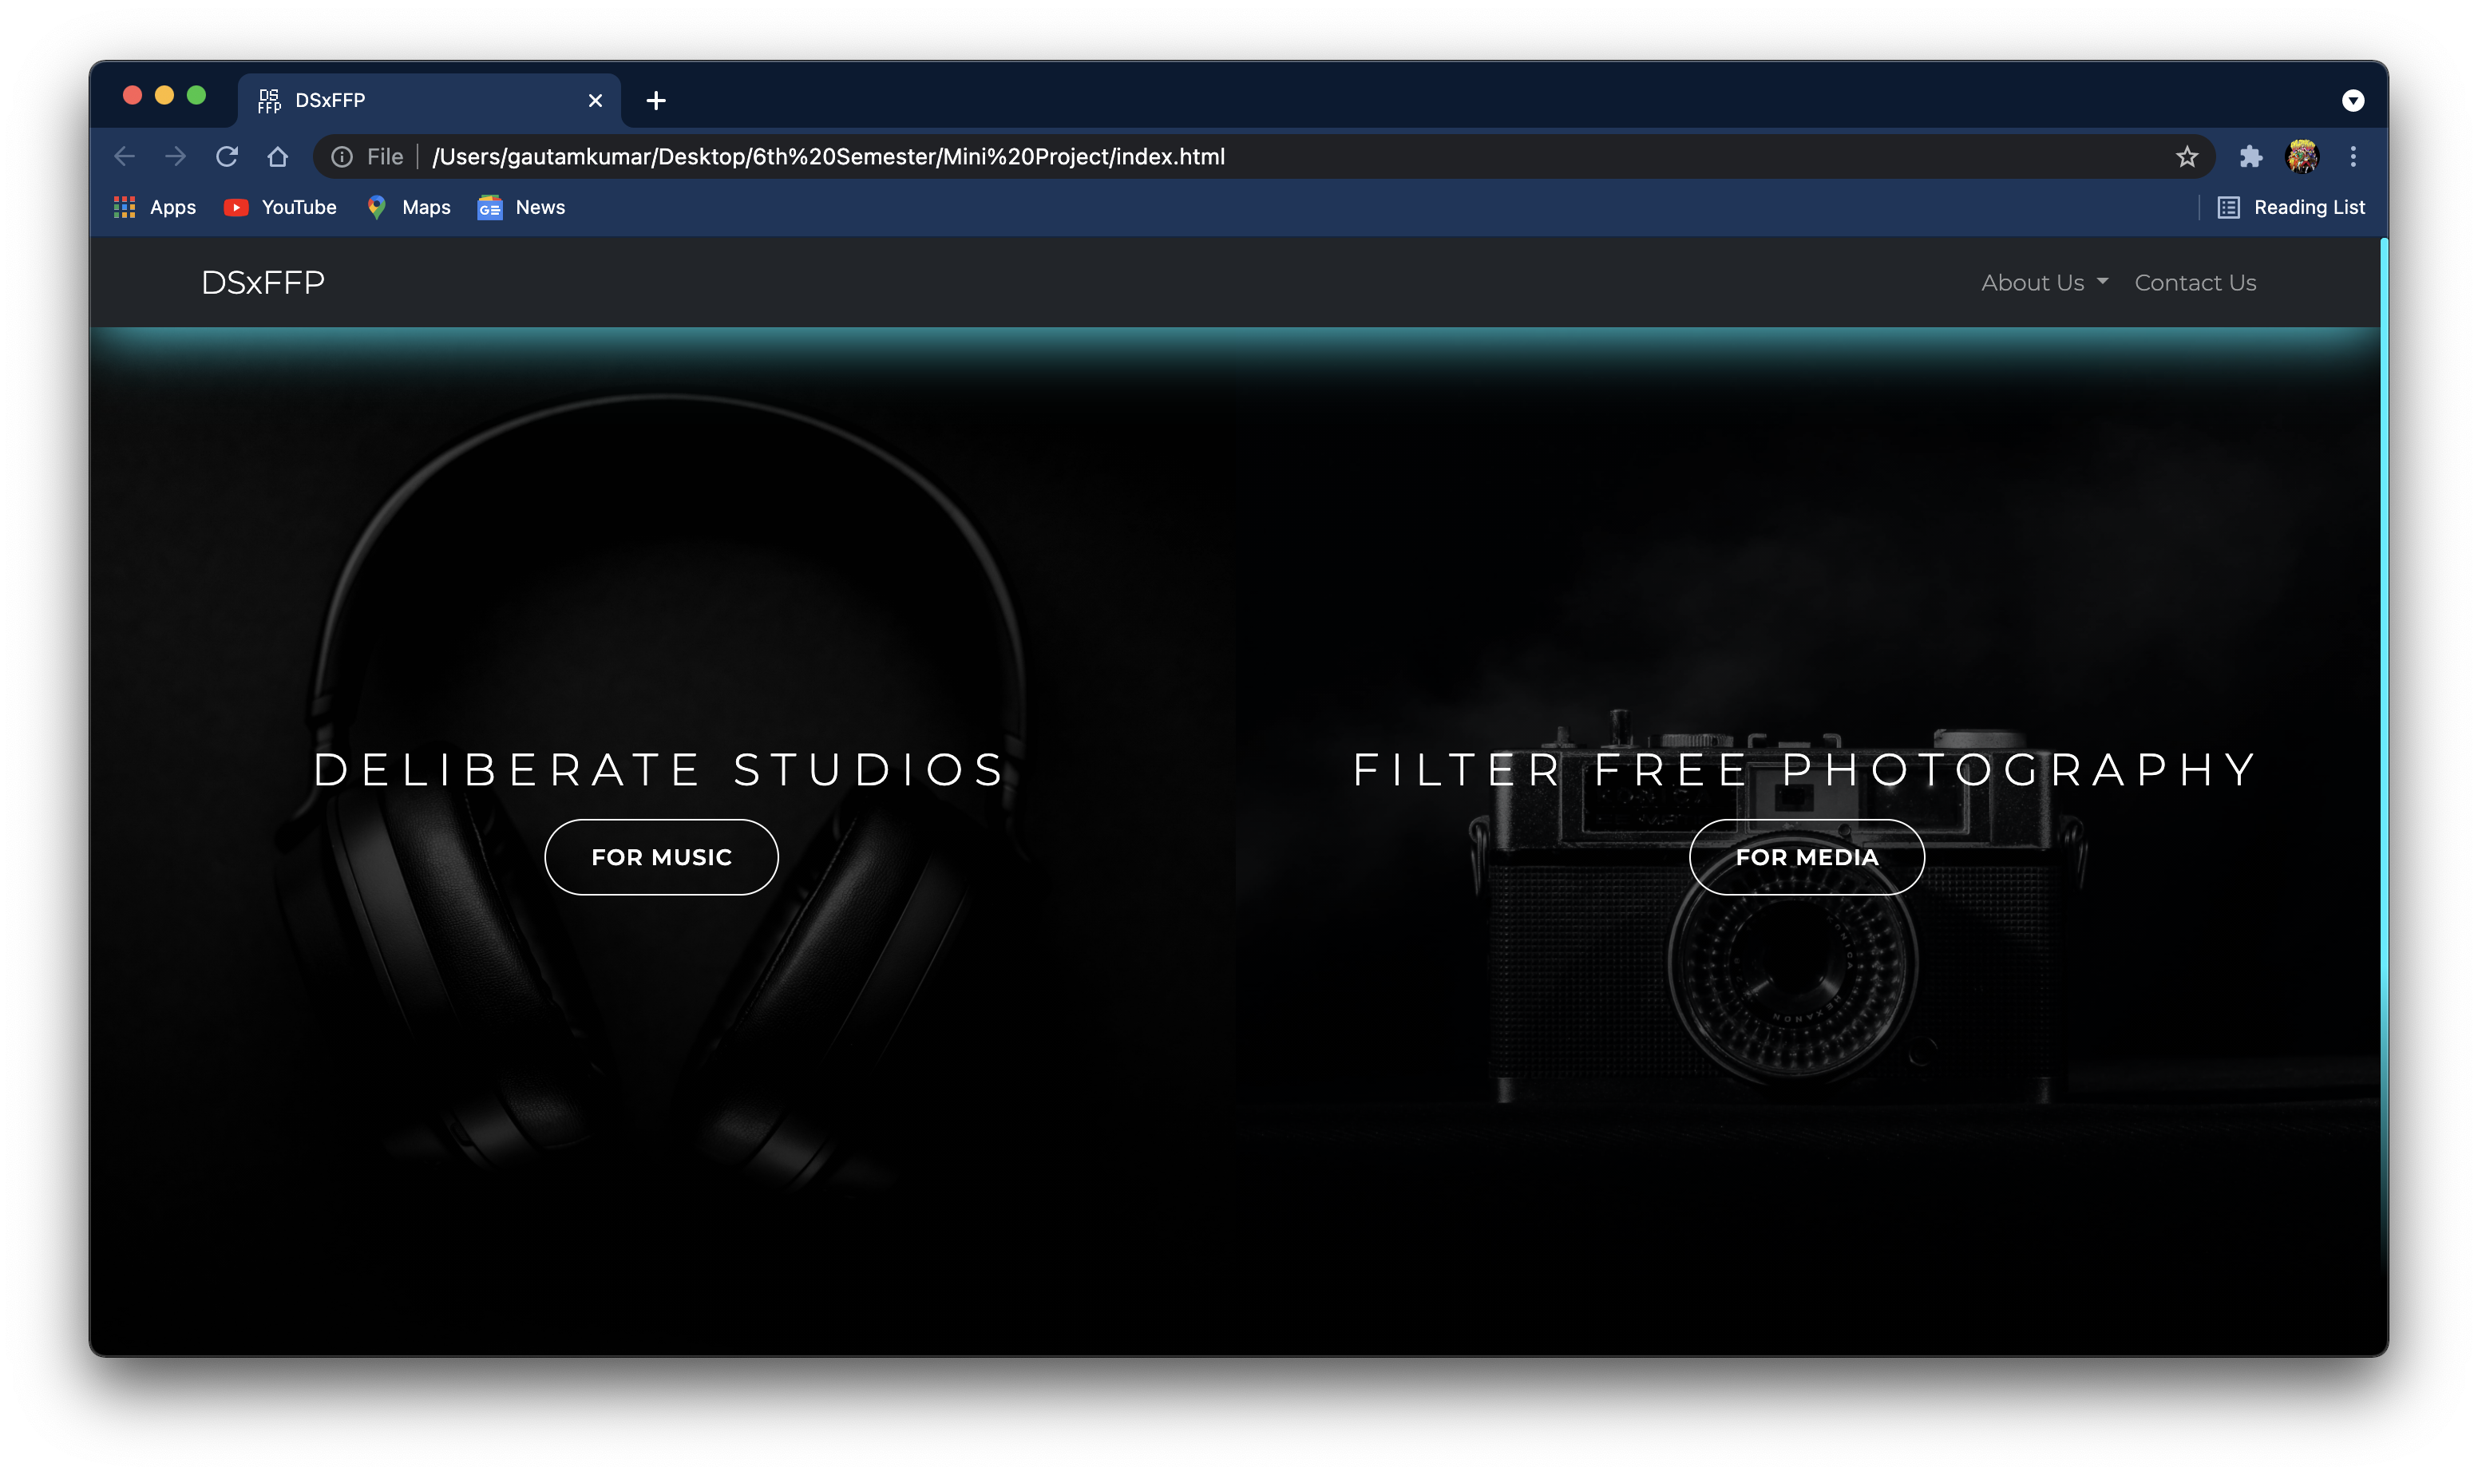
WEBSITE SCREENSHOTS

Slide 6
CONCLUSION
Our page showcases work in fields of music and media.
It shows the various works of our page admins and.
We would also like to upload our user’s work and displaying on our page and storage in a database.
This enables users to showcase their work and display on our website and enhance the audience to increase popularity in these fields.

Slide 7
REFERENCES
Photo gallery: https://mdbootstrap.com/docs/b4/jquery/plugins/video/#modal
Video modal: https://mdbootstrap.com/docs/b4/jquery/plugins/video/#modal
Music Player: https://www.youtube.com/watch?v=1-CvPn4AbT4
Photo Editor: https://www.youtube.com/watch?v=MYnyRwzwKm0
Contact Form: https://www.youtube.com/watch?v=rpujWVkmiPE
Connecting Contact Form to Email: https://formsubmit.co/

